Slide 1

RECURSION

Slide 2
What is Recursion ?
Recursion is process in which a function calls itself directly or indirectly and that corresponding function is called recursive function
Properties of Recursion:
  Performing the same operations multiple times with different inputs.
  In every step, we try smaller inputs to make the problem smaller.
  Base condition is needed to stop the recursion otherwise infinite loop will occur.

Slide 3
Steps to implement Recursion
Define a base case: Identify the simplest case for which the solution is trivial. This base case should be your stopping condition. Base case should prevent the function from running in infinite loop
Define a Recursive case: Define a problem in terms of subproblems. Break the problem down into smaller versions of itself, and call the function recursively to solve each subproblem
Recursion Termination: Even though we have a base case make sure the recursion terminates itself
Focus on on the bigger solution: After ensuring the base case validation and splitting up problems to subproblems focus on solving the bigger problem

Slide 4
Lerning Recursion with Towers of Hanoi
The Towers of Hanoi is a classic problem in computer science and mathematics. It consists of three rods and a number of disks of different sizes that can slide onto any rod. The problem starts with all the disks stacked in ascending order of size on one rod, with the smallest disk at the top and the largest at the bottom.
The goal is to move the entire stack to another rod, following these rules:
  Only one disk can be moved at a time.
  Each move consists of taking the top disk from one stack and placing it onto another stack.
  No disk may be placed on top of a smaller disk

Slide 5
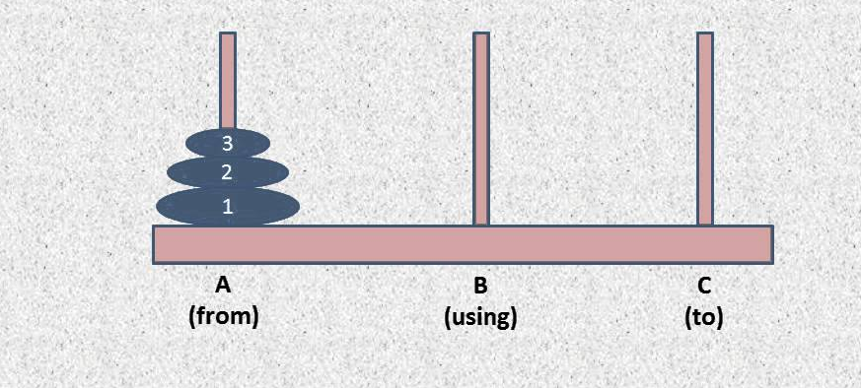
Lerning Recursion with Towers of Hanoi

Slide 6
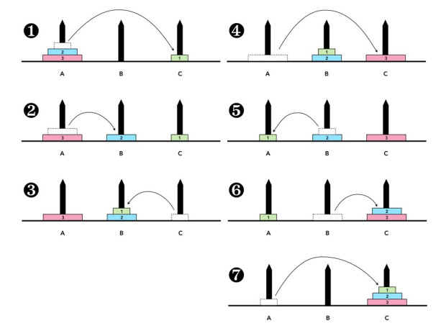
Lerning Recursion with Towers of Hanoi

Slide 7
Lerning Recursion with Towers of Hanoi
def hanoi(n, a, b, c):
  if n == 1:
    print("Move disk 1 from rod", a, "to rod", c)
    return
  hanoi(n-1, a, c, b)
  print("Move disk", n, "from rod", a, "to rod", c)
  hanoi(n-1, b, a, c)
n = 2
hanoi(n, 's', 'h', 'd')

Slide 8
Lerning Recursion with Towers of Hanoi
Step 1: n
N-1 call Hanoi function with a as the source
C as the aux
B as the dest
Step 2: Calling Hanoi for n-1 we are left with base case 1 and for base case 1
A is the source
B is the aux
C is the dest
def hanoi(n, a, b, c):
  if n == 1:
    print("Move disk 1 from rod", a, "to rod", c)
  return
  hanoi(n-1, a, c, b)
  print("Move disk", n, "from rod", a, "to rod", c)
  hanoi(n-1, b, a, c)
n = 2
hanoi(n, 's', 'h', 'd')

Slide 9
Lerning Recursion with Towers of Hanoi
Step 3: Base case will return and the next step executes which is hanoi(n-1, b, a, c)
Here b is the source
A is the aux and
C is the dest
def hanoi(n, a, b, c):
  if n == 1:
    print("Move disk 1 from rod", a, "to rod", c)
  return
  hanoi(n-1, a, c, b)
  print("Move disk", n, "from rod", a, "to rod", c)
  hanoi(n-1, b, a, c)
n = 2
hanoi(n, 's', 'h', 'd')

Slide 10
Lerning Recursion with Towers of Hanoi
Move disk 1 from rod s to rod d
Move disk 2 from rod s to rod a
Move disk 1 from rod d to rod a
Move disk 3 from rod s to rod d
Move disk 1 from rod a to rod s
Move disk 2 from rod a to rod d
Move disk 1 from rod s to rod d
def hanoi(n, a, b, c):
  if n == 1:
    print("Move disk 1 from rod", a, "to rod", c)
  return
  hanoi(n-1, a, c, b)
  print("Move disk", n, "from rod", a, "to rod", c)
  hanoi(n-1, b, a, c)
n = 3
hanoi(n, 's', 'h', 'd')
Towers of Hanoi Detailed explanation

Slide 11
Memory usage in Recursion
Recursion uses more memory, because the recursive function adds to the stack with each recursive call, and keeps the values there until the call is finished. The recursive function uses LIFO (LAST IN FIRST OUT) Structure just like the stack data structure
A recursive function calls itself, the memory for a called function is allocated on top of memory allocated to the calling function and a different copy of local variables is created for each function call. When the base case is reached, the function returns its value to the function by whom it is called and memory is de-allocated and the process continues.
When the recursion doesn’t end and executes continuously it results in stack overflow

